Slide 1
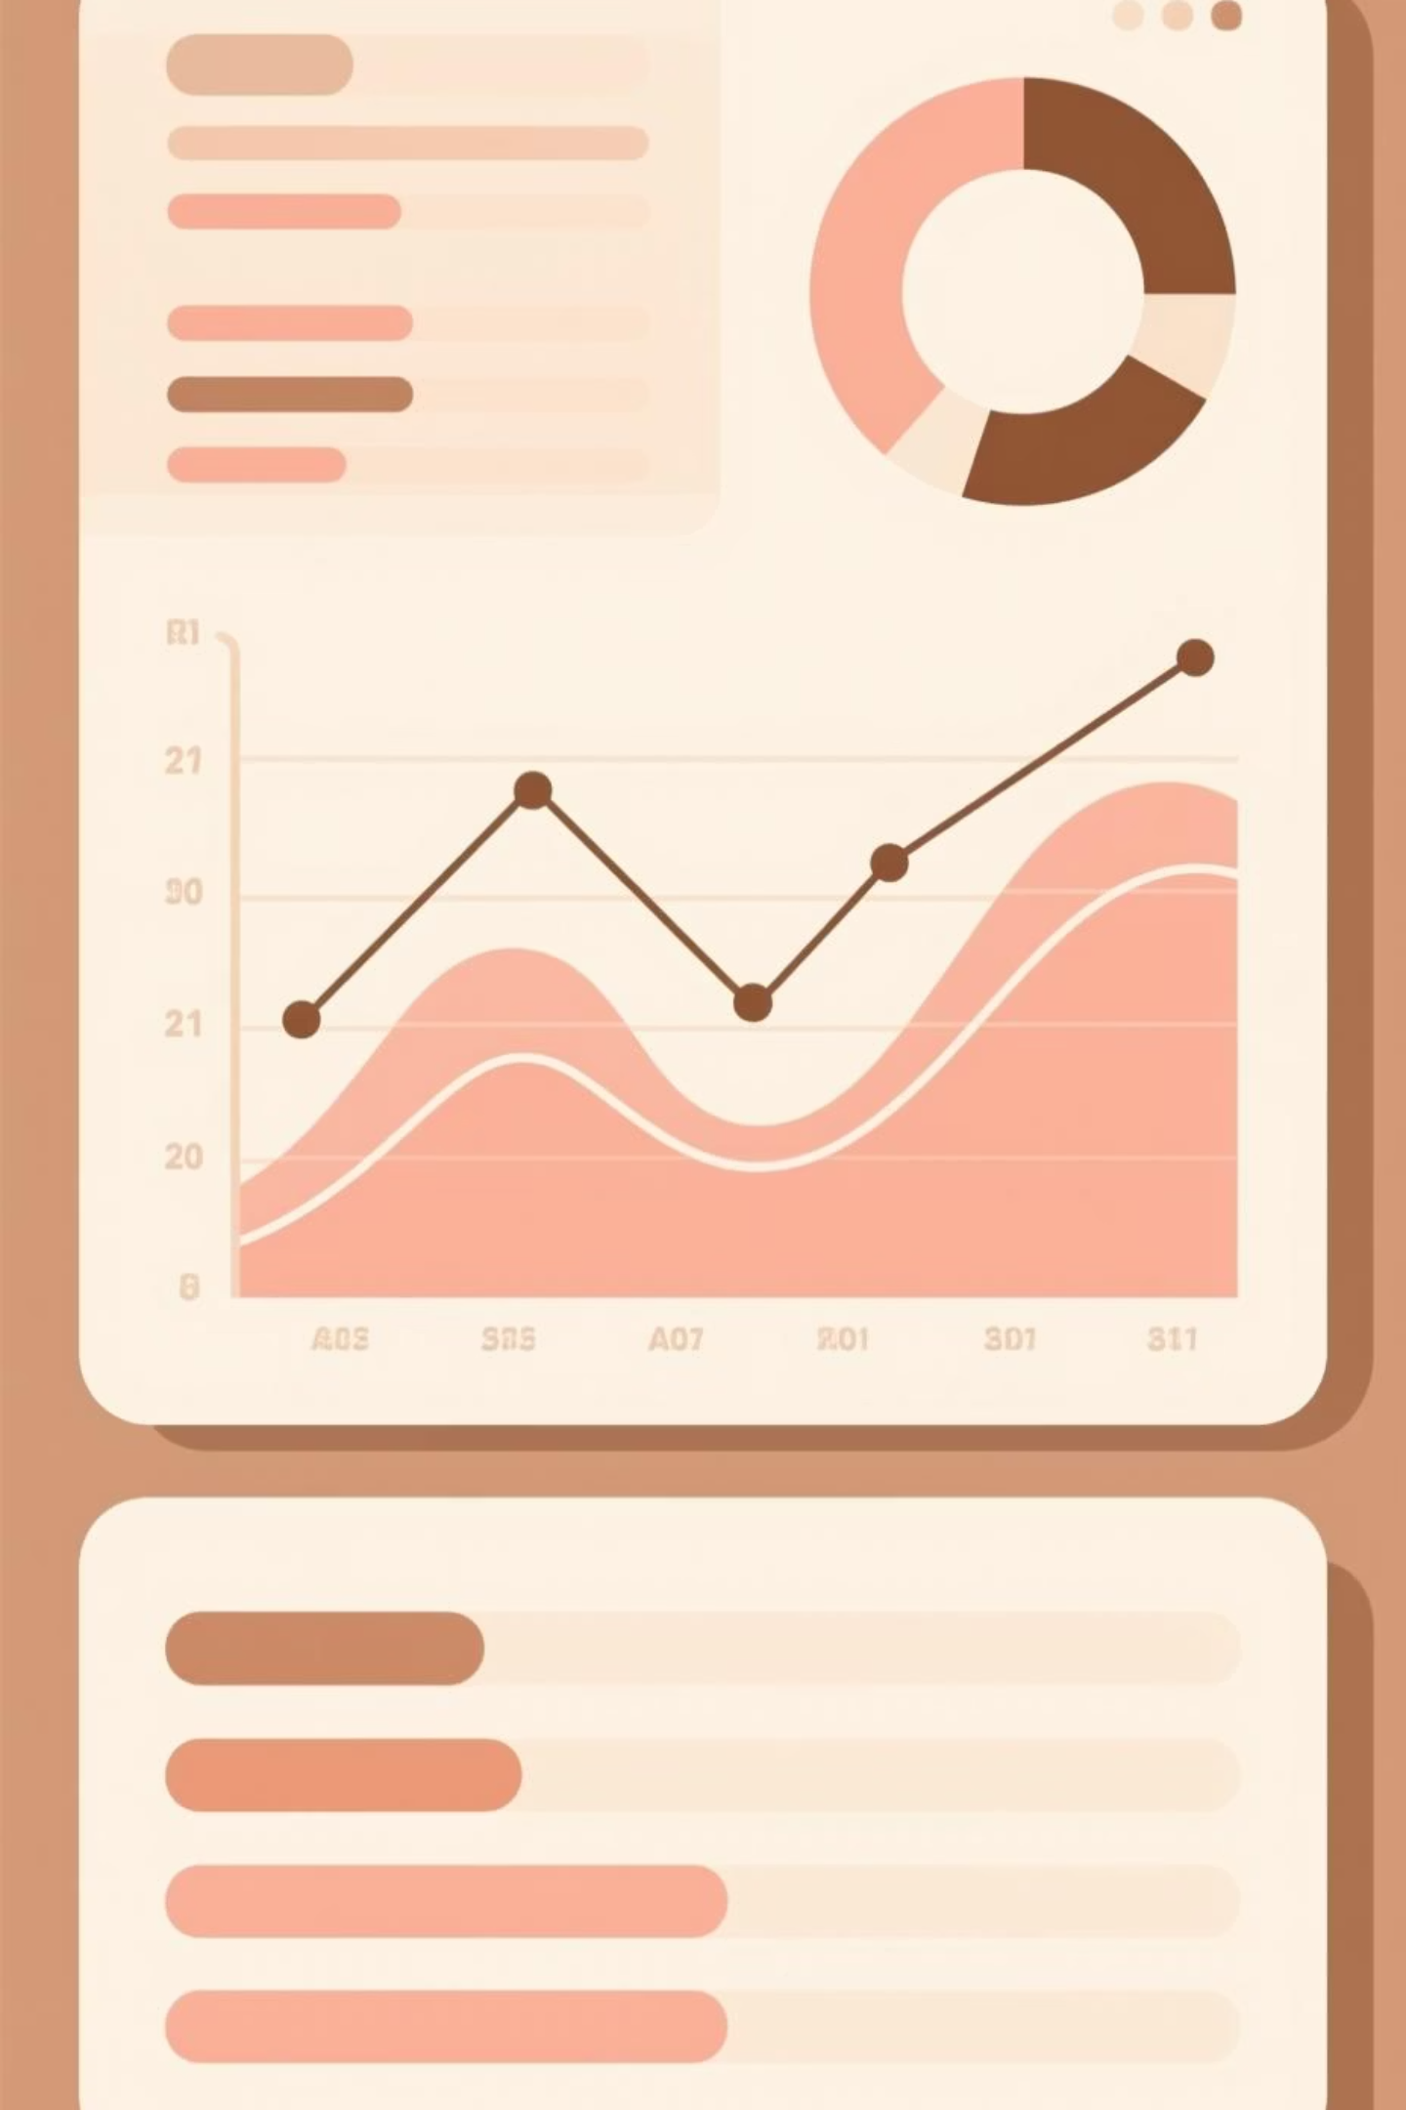
Netflix Titles Analysis Dashboard
Intern Presentation
Intern Name
[Mohit Sharma] Intern ID : DN1/F10/10017
Tools Used
Power BI & Python
Company Name
[Dynamix Networks]
Duration
[10/10/2025 to 05/11/2025]

Slide 2

Project Overview: Uncovering Netflix's Content Strategy
The primary objective of this internship project was to conduct a comprehensive analysis of Netflix’s movies and TV shows dataset. This exploration was designed to reveal underlying patterns in content acquisition and production.
Content Trends
Investigating the evolution of content over time.
Genre Distribution
Identifying the most and least represented content categories.
Ratings Overview
Analyzing the target demographic based on content rating.
Regional Content Spread
Mapping the global footprint of Netflix's library.
The final output is an interactive Power BI dashboard for dynamic visualization of these insights.

Slide 3




Data Cleaning & Preprocessing: Ensuring Data Integrity
Data preparation was performed using Python (Pandas) to ensure the dataset was pristine before being imported into Power BI for visualization.
Incorrect Entry Deletion
Duplicate and Missing Data Removal
Removed erroneous entries in the "type" column, such as misspelled categories or blank fields.
Identified and eliminated both missing values (NaN) and duplicate records to maintain accuracy.
Final Export
Data Standardization
The cleaned dataset was saved as netflix_cleaned.csv, ready for Power BI import.
Standardized key fields like date formats and country names for consistent analysis across the dataset.

Slide 4
Technology Stack and Roles
A combination of powerful tools was leveraged for data manipulation, analysis, and interactive visualization.
Python (Pandas, NumPy)
Primary environment for detailed data cleaning, transformation, and large-scale data manipulation.
Power BI Desktop
Core tool for sophisticated data visualization, report design, and creation of the final interactive dashboard.
Power Query Editor
Used for initial data shaping, filtering, and defining the data source structure within the Power BI workflow.
DAX Expressions
Implemented for creating complex calculated fields, custom Key Performance Indicators (KPIs), and advanced data modeling logic.

Slide 5




Dashboard Components and Visual Strategy
The interactive dashboard was designed to provide both a high-level overview and drill-down capability into the content library.
Key Performance Indicators
Total Movies, Total TV Shows, and Global Reach (Total Countries).
Regional Distribution
Visualized using a Shape Map to show content origin density.
Content Trends Analysis
Line Chart demonstrating content volume release over time.
Genre Popularity
Bar Chart ranking the most frequent genres.

Slide 6


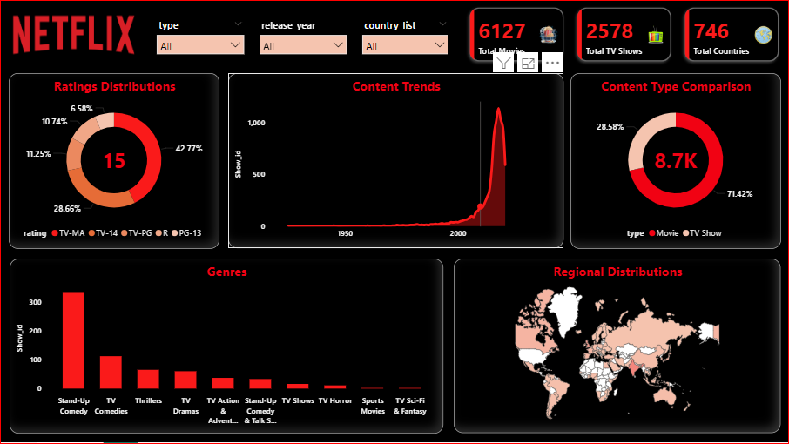
Ratings Distributions
Visualized using a Donut Chart to show ratings distributions.
Content Type Comparison
Visualized using a Donut Chart to show content type comparison.

Slide 7
Core Metrics: Key Performance Indicators
The total library size and distribution by type provide an immediate snapshot of Netflix's content focus.
6,127
2,578
8.7K
746
Total Movies
Total TV Shows
Total Titles
Country Origins
The count of all available full-length motion pictures in the dataset.
The total number of available serialized television programs.
Combined size of the content library, demonstrating scale.
Number of unique countries where the content originated, indicating global reach.
These metrics highlight the large volume of content managed and analyzed, setting the stage for deeper trend investigation.

Slide 8




High-Impact Insights and Findings
Movie Dominance
Movies make up approximately 71% of the total library, confirming a primary focus on film content.
TV Content Growth
TV Shows account for approximately 29%, showing Netflix's growing commitment to serial, long-form storytelling.
Genre Popularity
Stand-Up Comedy, Thrillers, and Dramas consistently rank as the top genres, suggesting strong viewer demand in these categories.
Audience Targeting
The majority of content is rated TV-MA and TV-14, indicating a deliberate targeting of mature and young adult audiences.
Content Expansion
There was a sharp rise in content acquisition and release after 2010, correlating directly with Netflix's aggressive global market expansion.
Truly Global Reach
Content diversity is high, with titles originating from 746 unique countries, reinforcing Netflix's international strategy.

Slide 9

Overcoming Implementation Challenges
During the development phase, several technical hurdles were encountered and resolved, providing valuable lessons in data visualization workflow.
1
Incorrect Entries in "Type" Column
Solution: Permanent removal and cleansing executed within the Power Query Editor before visualization was initiated.
2
Missing "Size" Field in Map Visual
Solution: Adjusted settings to utilize the auto-bubble scaling feature within Power BI to accurately reflect data density by region.
3
Map Not Displaying Geographic Data Correctly
Solution: Switched the visual type to a Shape Map and integrated a custom JSON file for precise boundary and region display.
4
Data Preview Limited to 1000 Rows
Solution: Configured Power BI to load the full dataset, overriding default sampling limits and ensuring complete data analysis.

Slide 10

Project Conclusion and Strategic Takeaways
Content Strategy Balance
Global Presence
The library is movie-heavy (~71%), while TV content shows significant and rapid expansion, pointing to future serialized growth.
Netflix’s reach is validated by content from over 700 countries, confirming its status as a major global content distributor.
Effective Visualization
Dominant Genres
The Power BI dashboard provides a clear, actionable visualization of Netflix’s complex content acquisition and distribution strategy.
High-demand genres like Comedy and Thriller are strategically prioritized across regions to maximize viewership.

Slide 11


Key Learning Outcomes from the Internship
This project provided hands-on experience and reinforced critical skills vital for a career in Business Intelligence and data analysis.
Data Preparation Mastery
Visualization Expertise
Advanced techniques in data cleaning and preprocessing using Python (Pandas).
Professional-level data visualization and interactive dashboard creation using Power BI.
BI Tool Proficiency
Data Storytelling
Practical, hands-on application of Power Query for data shaping and DAX for calculated metrics.
Translating complex analytical findings into clear, concise, and actionable business insights.

